Slide 1
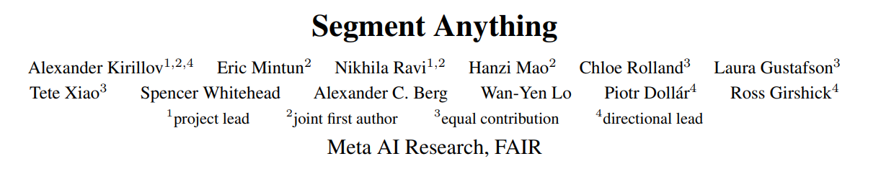
2023.05.17 공학 딥러닝
이소영
2023 arXiv
Facebook research

Slide 2
Contents
Abstract
Introduction
Segment Anything
Task
Model
Data Engine
Dataset
Zero-Shot Transfer Experiments
Discussion

Slide 3
Abstract
Segment Anything (SA) project: a new task, model, and dataset for image segmentation
The largest segmentation dataset: over 1 billion masks on 11M images.
The model is designed and trained to be promptable.
Its capabilities on numerous tasks and find that its zero-shot performance is impressive.

Slide 4
Introduction
Revolutionizing NLP
Large language models pre-trained on web-scale datasets = foundation models
Implemented with prompt engineering
Abundant text corpora from the web → zero & few-shot performance compare surprisingly well to fine-tuned models
Empirical trends: improving with model scale, dataset size, and total training compute
Foundation models in computer vision
Paired text and images align from the web (ex. CLIP)
Abundant training data does not exist
Prompt
: hand-crafted text
Language model
Valid textual response for the task at hand

Slide 5
Introduction
Our goal: build a foundation model for image segmentation
The success of this plan hinges on three components: task, model, and data.
To develop them, we address the following questions about image segmentation:
What task will enable zero-shot generalization?
What is the corresponding model architecture?
What data can power this task and model?
→ Promptable segmentation task
→ Supports flexible prompting
→ Diverse, large-scale source of data

Slide 6
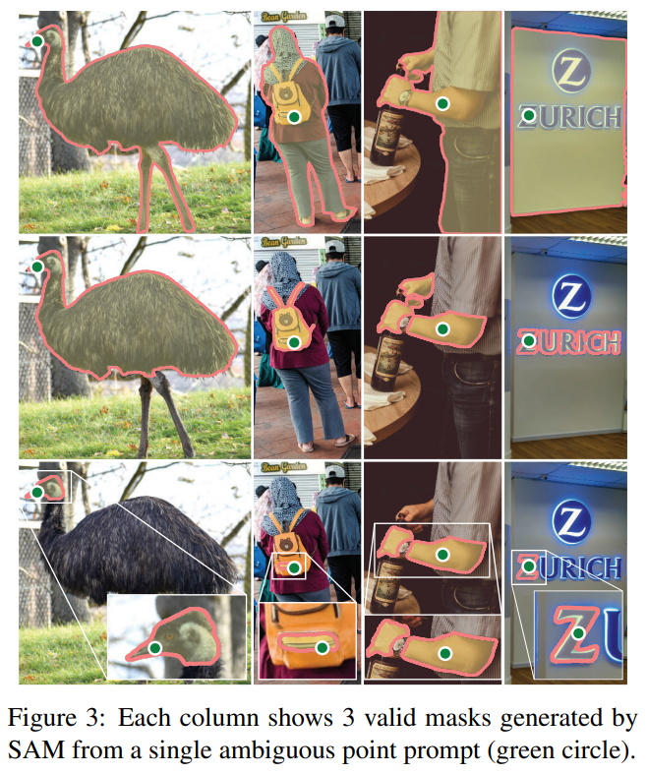
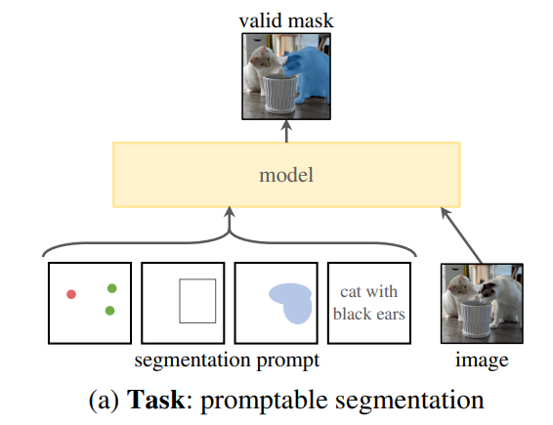
Segment Anything - Task
Promptable segmentation task
Return a valid segmentation mask given any segmentation prompt
When a prompt is ambiguous and could refer to multiple objects, the output should be a reasonable mask for at least one of those objects.
Simply specifies what to segment in an image
(e.g., point, bbox, mask, or text information identifying an object)

Slide 7
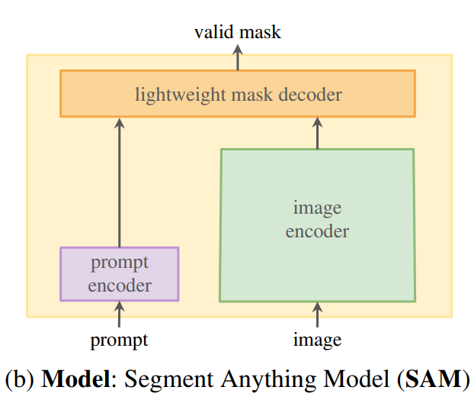
Segment Anything - Model
Constraints on the model architecture
Must support flexible prompts
Needs to compute masks in amortized real-time to allow interactive use
Must be ambiguity-aware
→ Segment Anything Model (SAM)
(multiple)

Slide 8
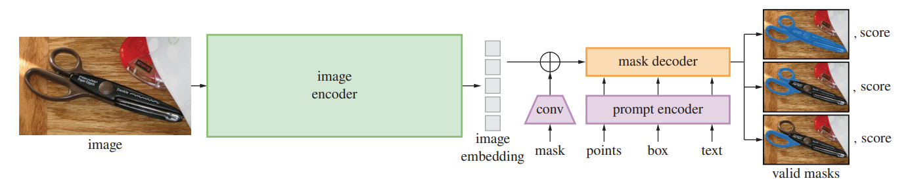
Segment Anything - Model
Image encoder
Masked Autoencoder (MAE) pre-trained Vision Transformer (ViT): ViT-H/16
Computed only once per image, not per prompt
→ the prompt encoder and mask decoder predict a mask from a prompt in ∼50ms in a web browser

Slide 9
Segment Anything - Model
Image encoder
Masked Autoencoder(MAE) pre-trained Vision Transformer (ViT): ViT-H/16
Computed only once per image, not per prompt
→ the prompt encoder and mask decoder predict a mask from a prompt in ∼50ms in a web browser
Input
image
ViT-H/16
(image encoder)
1024x1024
resize
(256x64x64)

Slide 10
Segment Anything - Model
Prompt encoder
Sparse prompts (points, boxes, text): mapped to 256- dimensional vectorial embeddings
Points: positional encoding of the point’s location + foreground/background embedding (learned)
Boxes: pair of two components
(1) the positional encoding of its top-left corner + learned embedding representing “top-left corner”
(2) the same structure but using a learned embedding indicating “bottom-right corner”
Free-from text: text encoder from CLIP
Dense prompts (masks): convolutions and summed element-wise with the image embedding

Slide 11
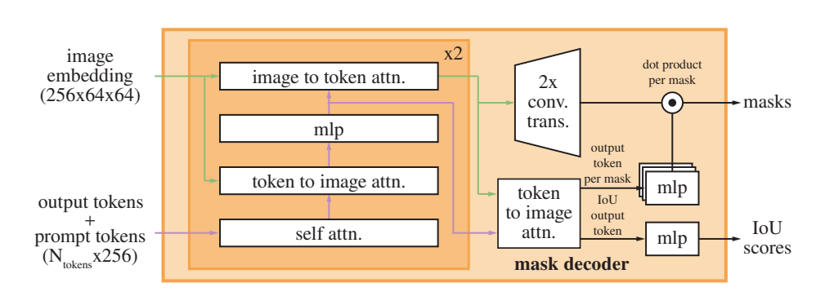
Segment Anything - Model
(Lightweight) Mask decoder
similar to
ViT [class] token

Slide 12
Segment Anything - Model
Resolving ambiguity
Predict 3 masks: whole, part, and subpart
Compute the loss between the ground truth and each of the predicted masks
but only backpropagate from the lowest loss
Add a small head: that estimates the IoU (score) between each predicted mask and the object it covers

Slide 13
Segment Anything - Model
Loss and training
Mask prediction: Focal loss + dice loss (20:1)
IoU prediction: mean-square-error (MSE) loss

Slide 14
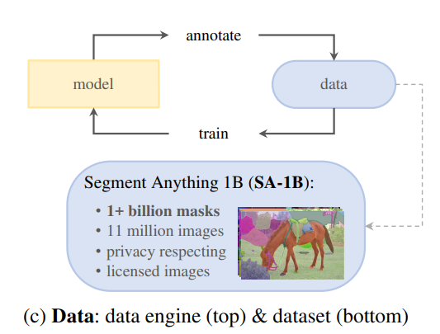
Segment Anything - Data Engine
1.1B mask dataset, SA-1B
The data engine has three stages:
Model-assisted manual annotation stage
Semi-automatic stage with a mix of automatically predicted masks and model-assisted annotation
Fully automatic stage in which our model generates masks without annotator input.

Slide 15
Segment Anything - Data Engine
1. Assisted-manual stage
Human
Clicking foreground / background object points → refine
Proceed to the next image once a mask took over 30 seconds to annotate
SAM
Start: trained using common public segmentation datasets
retrained using only newly annotated masks (retraining 6 times)
SAM scaled from ViT-B to ViT-H
Overall, we collected 4.3M masks from 120k images in this stage.

Slide 16
Segment Anything - Data Engine
2. Semi-automatic stage
Aim: increase the diversity of masks
First automatically (SAM) detected confident masks → annotate (human) any additional unannotated objects
Detect confident masks
Trained a bounding box detector(Faster R-CNN) on all first stage masks using a generic “object” category.
Collected an additional 5.9M masks in 180k images (for a total of 10.2M masks).

Slide 17
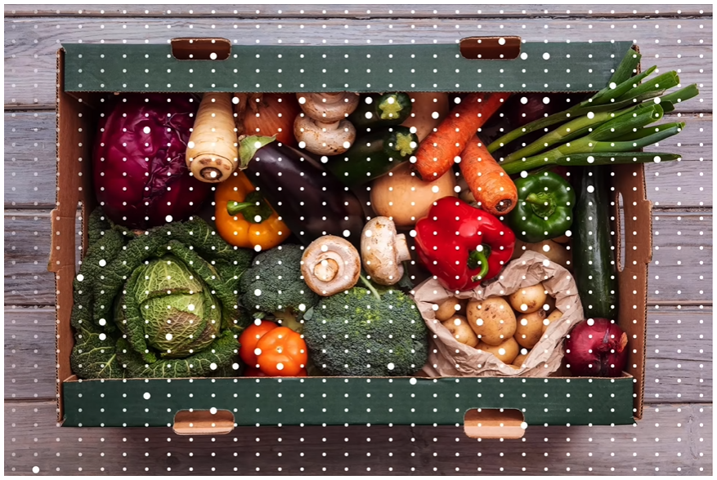
Segment Anything - Data Engine
3. Fully automatic stage
Developed the ambiguity-aware model
Prompt: the model with a 32×32 regular grid of points
Select confident masks
A mask stable if thresholding the probability map at 0.5 − δ and 0.5 + δ results in similar masks
Filter duplicates: using non-maximal suppression (NMS)
Fully automatic mask generation to all 11M images, producing a total of 1.1B high-quality masks

Slide 18
Segment Anything - Dataset
Dataset: SA-1B
Images
11M diverse, licensed
High-resolution: 3300×4950 pixels on average
Masks
Data engine produced 1.1B masks, 99.1% of which were generated fully automatically.
Quality analysis → SA-1B only includes automatically generated masks

Slide 19
Segment Anything - Dataset
Mask quality
Randomly sampled 500 images (∼50k masks)
→ professional annotators to improve the quality of all masks in these images.
Pairs of automatically predicted and professionally corrected masks
94% of pairs have greater than 90% IoU (97% of pairs have greater than 75% IoU)
Prior work estimates inter-annotator consistency at 85-91% IoU

Slide 20
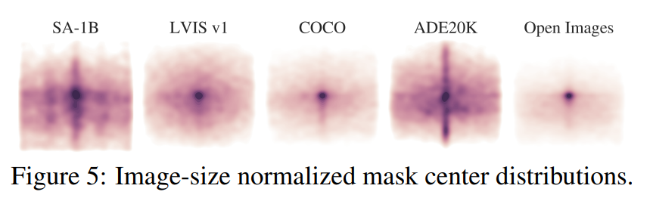
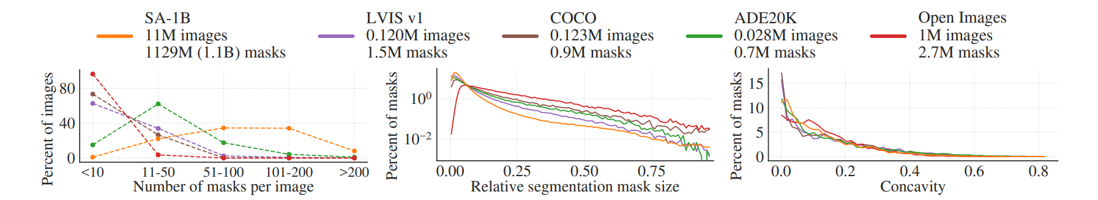
Segment Anything - Dataset
Mask properties
Greater coverage of image corners
Compare by size
more masks per image
greater percentage of
small and medium
relative-size masks
similar shape complexity

Slide 21
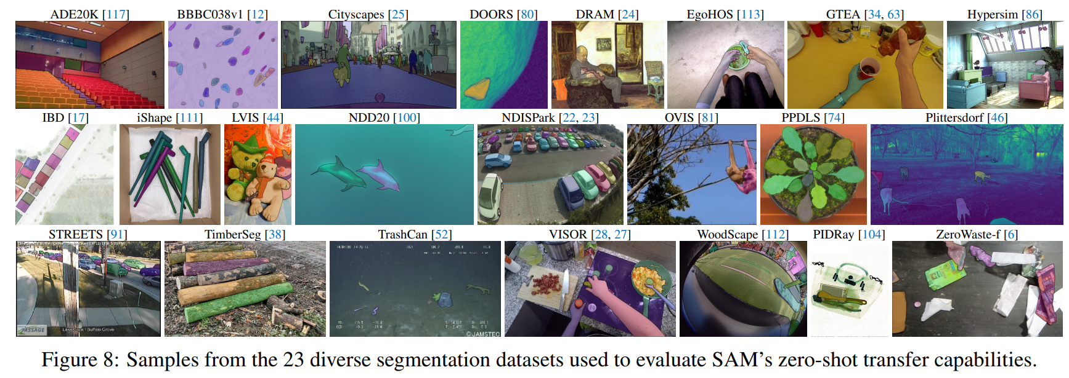
Zero-Shot Transfer Experiments
The datasets may include novel image distributions, such as underwater or ego-centric images that, to our knowledge, do not appear in SA-1B.

Slide 22
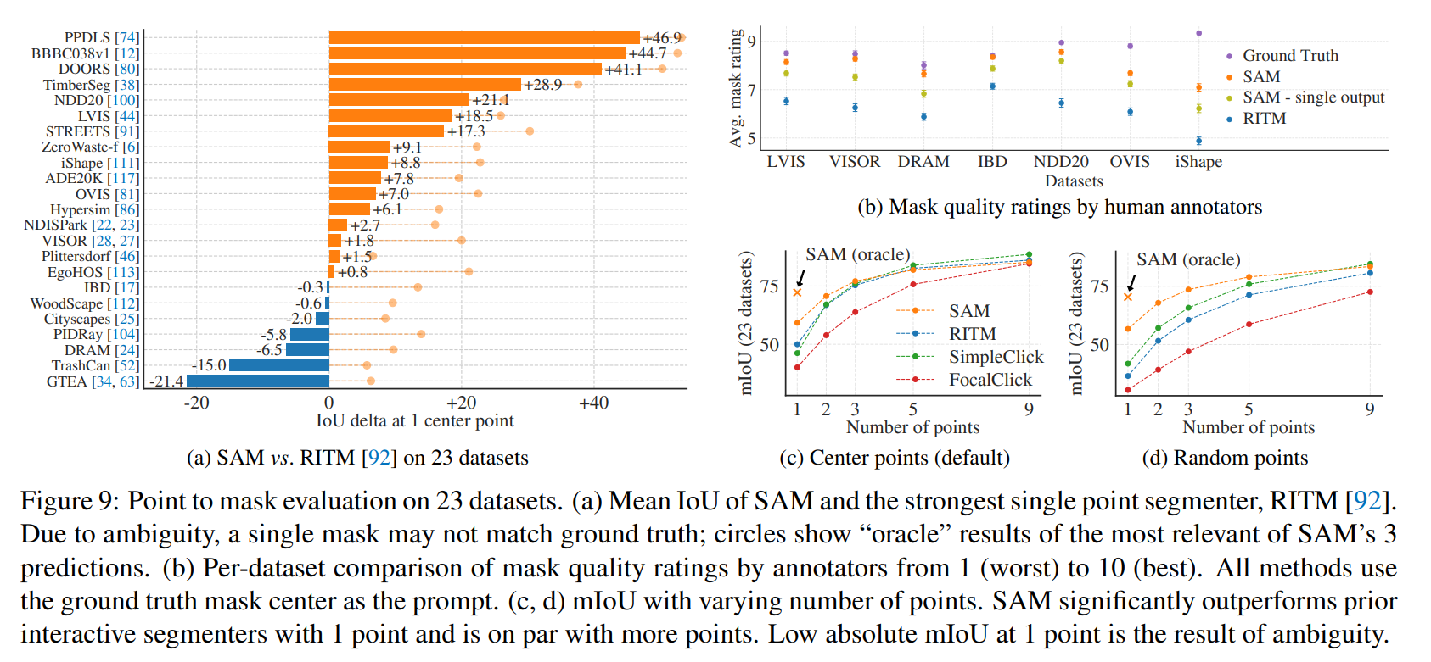
Zero-Shot Transfer Experiments
1. Zero-Shot Single Point Valid Mask Evaluation Task
Task: segmenting an object from a single foreground point
evaluate only the model’s most confident mask by default
Result
SAM yields higher results on 16 of the 23 datasets
“oracle” result: SAM outperforms RITM on all datasets
“oracle” result
- Most relevant of SAM’s 3 masks is selected by comparing them to the ground truth
- Reveals the impact of ambiguity on automatic evaluation

Slide 23
Zero-Shot Transfer Experiments
1. Zero-Shot Single Point Valid Mask Evaluation Task
Result
Annotators consistently rate the quality of SAM’s masks substantially higher than RITM
the number of points increases from 1 to 9
the gap between methods decreases
: task becomes easier
random point sampling
→ the gap between SAM and the baselines grows

Slide 24
Zero-Shot Transfer Experiments
2. Zero-Shot Edge Detection
Approach: evaluate SAM on the classic low-level task of edge detection using BSDS500
Using a simplified version of our automatic mask generation pipeline
edge maps are computed
Sobel filtering of unthresholded mask probability maps
Standard lightweight postprocessing, including edge NMS

Slide 25
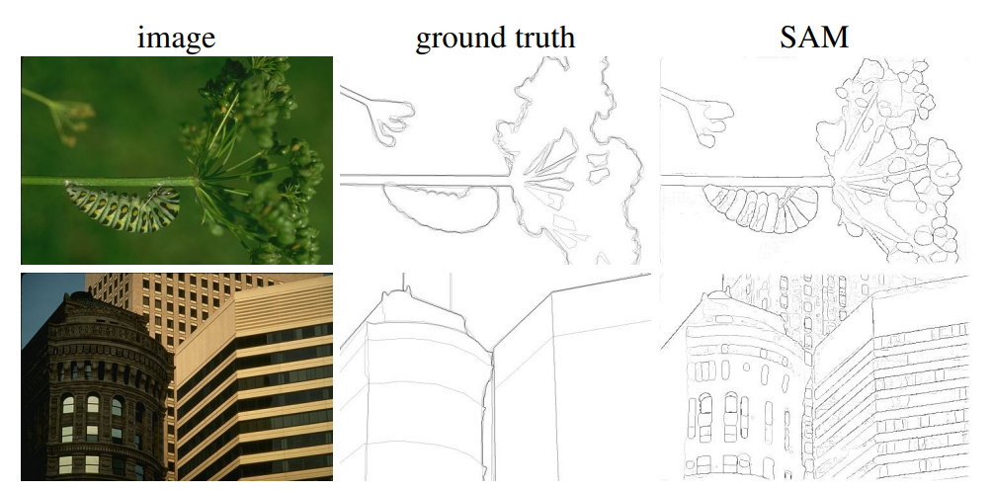
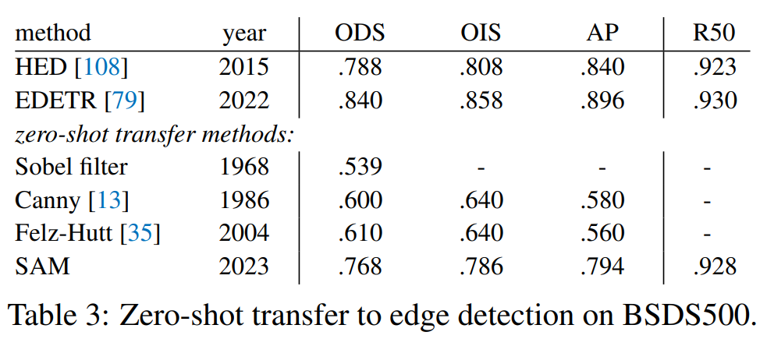
Zero-Shot Transfer Experiments
2. Zero-Shot Edge Detection
Results
4 standard metrics for edge detection
ODS: Optimal Dataset Scale
OIS: Optimal Image Scale
AP: Average Precision
R50: Recall at 50% precision
Qualitatively: produces reasonable edge maps
SAM predicts more edges (bias),
including sensible ones that are not annotated in BSDS500
SAM’s bias: high R50, but low AP
Better than zero-shot transfer methods

Slide 26
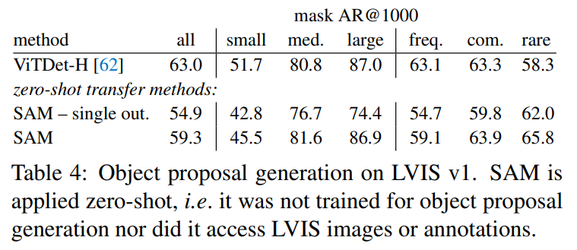
Zero-Shot Transfer Experiments
3. Zero-Shot Object Proposals
Approach: evaluate SAM on the mid-level task of object proposal generation
Compute the standard average recall (AR) metric for masks at 1000 proposals on LVIS v1
Results
ViTDet-H as object proposals performs the best overall
SAM does remarkably well on several metrics

Slide 27
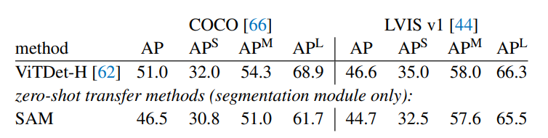
Zero-Shot Transfer Experiments
4. Zero-Shot Instance Segmentation
Approach: higher-level vision
Object detector (same as ViTDet) output boxes = prompt SAM
Results
AP metric: ViTDet-H > SAM on both datasets

Slide 28
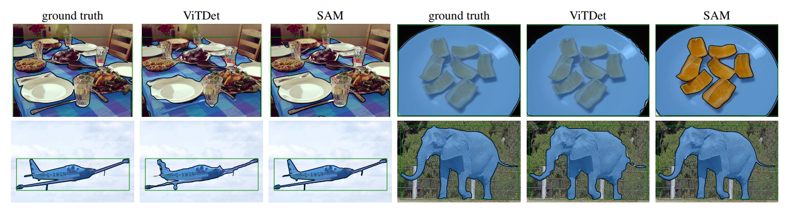
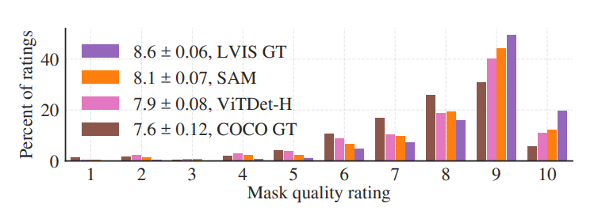
Zero-Shot Transfer Experiments
4. Zero-Shot Instance Segmentation
Results
SAM masks are often qualitatively better than those of ViTDet

Slide 29
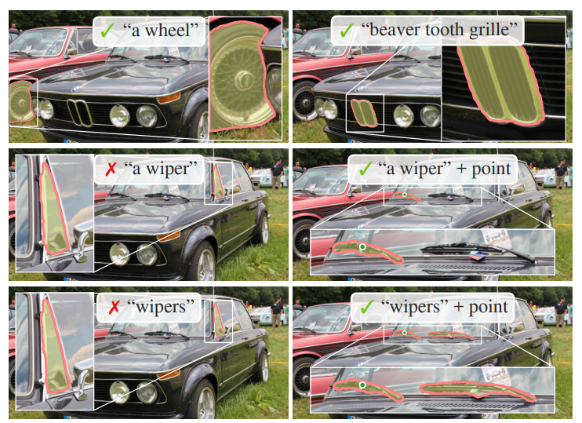
Zero-Shot Transfer Experiments
5. Zero-Shot Text-to-Mask
Approach: a proof-of-concept of SAM’s ability to process text prompts
Results
SAM can segment objects based on simple text prompts
SAM fails to make a correct prediction
→ an additional point prompt can help

Slide 30
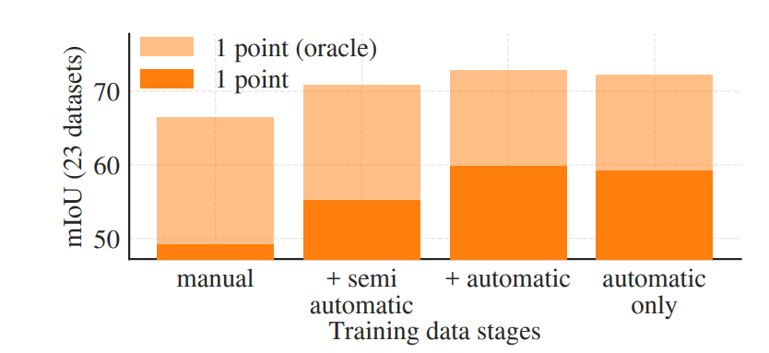
Zero-Shot Transfer Experiments
6. Ablations
Data engine stages
Each stage increases mIoU
Tested a fourth setup that uses only the automatically generated masks
to simplify the training setup
using

Slide 31
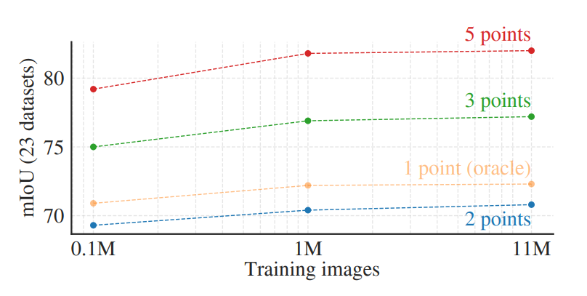
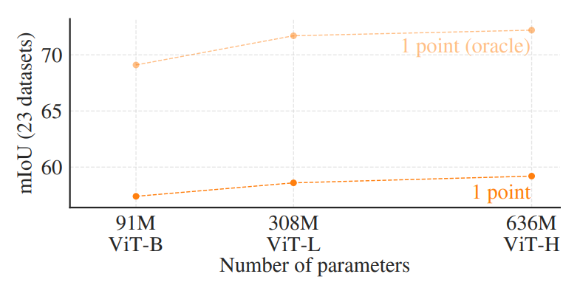
Zero-Shot Transfer Experiments
6. Ablations
Training data scaling
1M images: results comparable to using the full dataset
Image encoder scaling
Further image encoder scaling does not appear fruitful at this time

Slide 32
Discussion
Foundation models
Pre-trained model → foundation model (rebranded)
Trained on broad data at scale and are adaptable to a wide range of downstream tasks
Compositionality
New capabilities: used as a component in larger systems
Our goal is to make this kind of composition straightforward with SAM.
SAM to predict a valid mask for a wide range of segmentation prompts
→ create a reliable interface between SAM and other components

Slide 33
Discussion
Limitations
While SAM performs well in general, it is not perfect
Dedicated interactive segmentation methods to outperform SAM when many points are provided
Not real-time when using a heavy image encoder
Text-to-mask task is exploratory and not entirely robust
Unclear how to design simple prompts that implement semantic and panoptic segmentation
Conclusion
The Segment Anything project is an attempt to lift image segmentation into the era of foundation models.
Our principal contributions: a new task (promptable segmentation), model (SAM), and dataset (SA-1B)

Slide 34
END

